Slide 1
Creating Conference Proposals
August 30, 2023

Slide 2
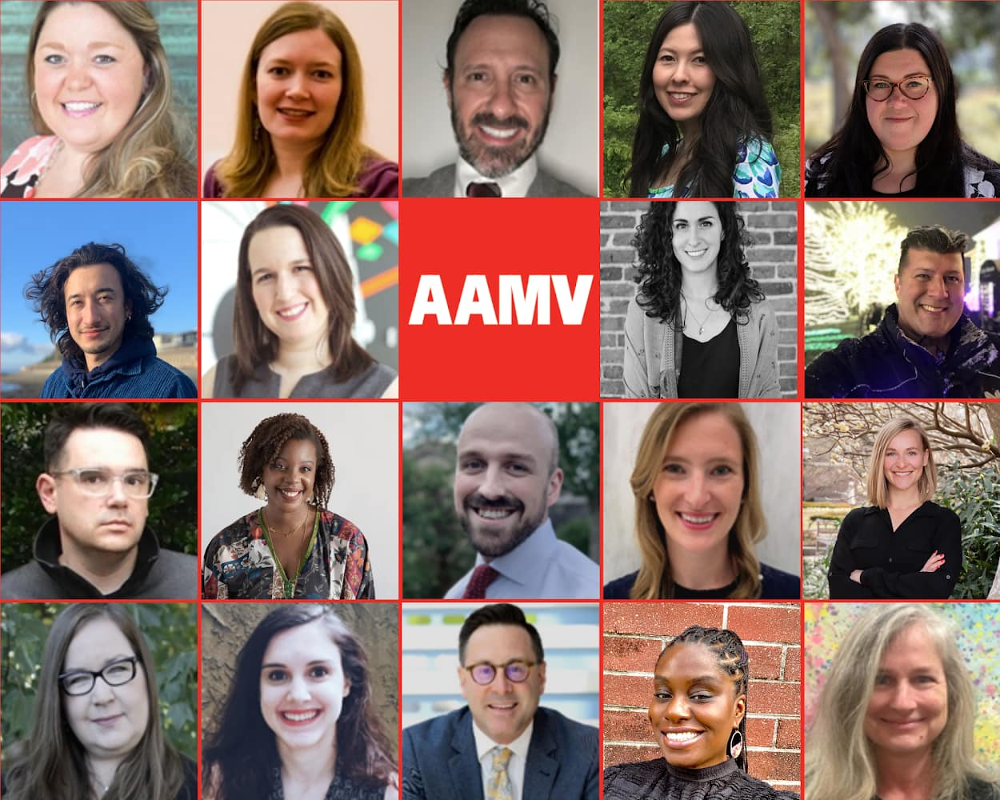
About AAMV
The American Association for Museum Volunteers (AAMV) is a professional network for anyone working with museum volunteers. We are committed to providing a forum for the discussion and distribution of best practices in the field of museum volunteering and internships, expanding opportunities for networking, and advocating for volunteers in museums.
AAMV.org

Slide 3
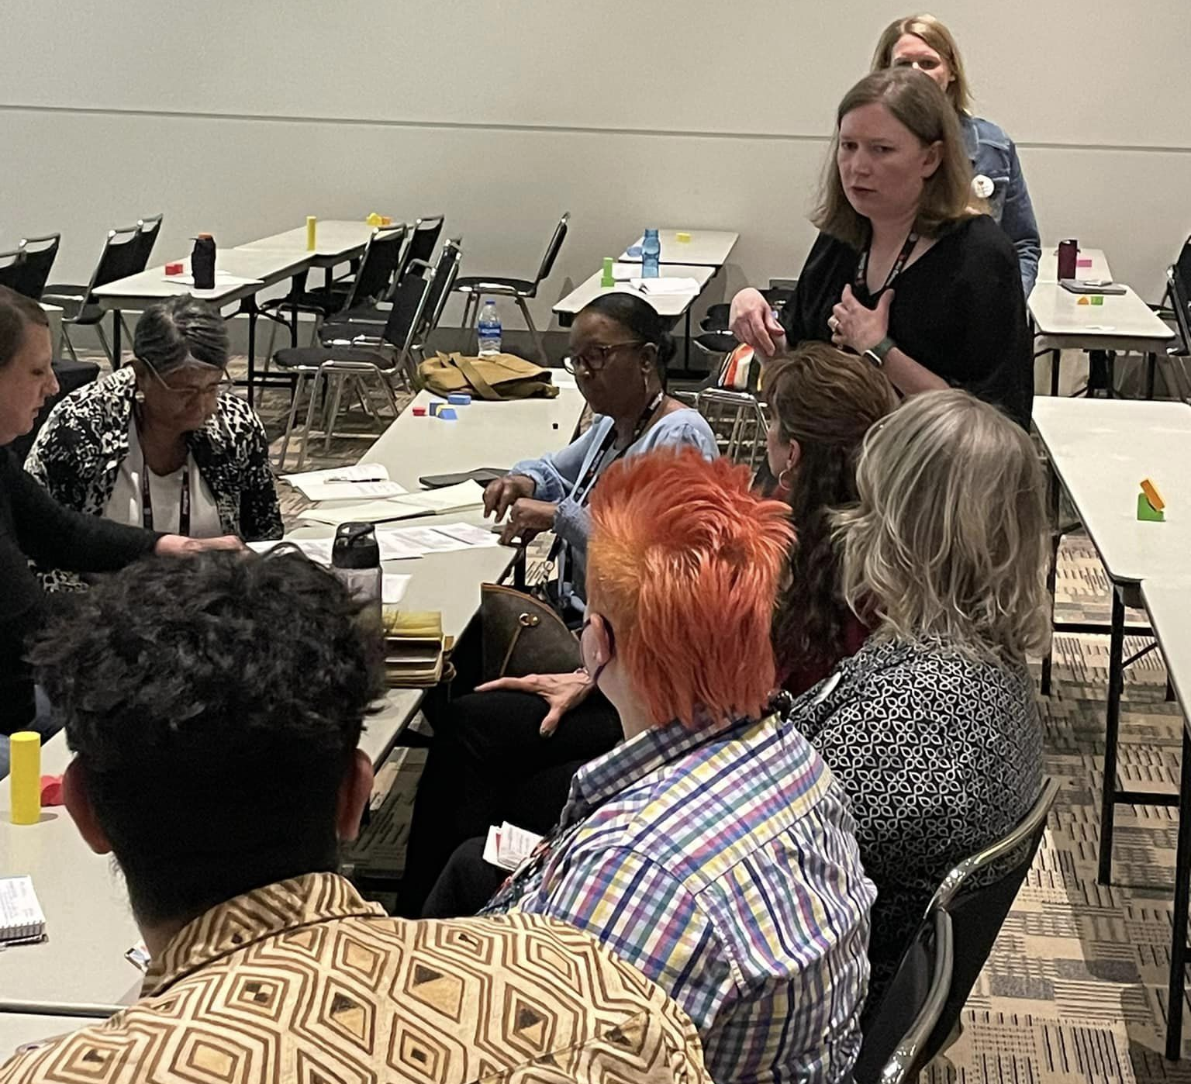
Session Types
Traditional panels
Interactive roundtable discussions
Case-specific presentations (“Flash sessions” for AAM)
Workshops
Other: be creative!

Slide 4
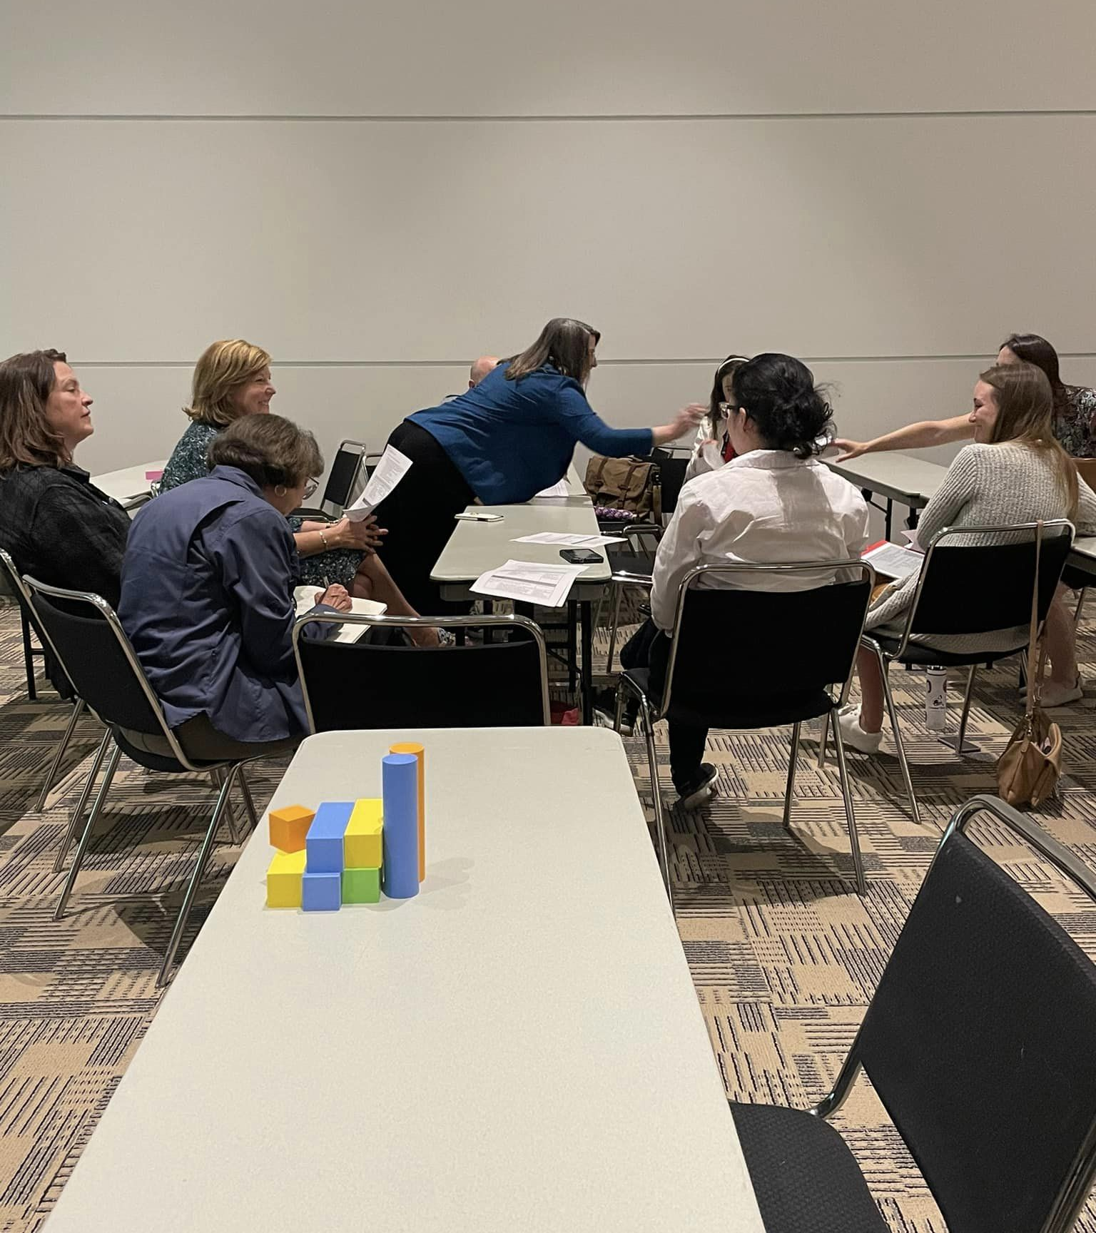
Keep it interactive!
Prioritize interactivity in your proposal
Avoid “talking at” your audience
Include answers to the following:
How will you encourage audience engagement?
How will you make the issues discussed relevant to the concerns of your audience?
How is your session idea more engaging than the traditional conference format?
Let’s take a moment to throw around some ideas on how to make conference sessions more engaging.
Have you attended a particularly engaging session at a recent conference?

Slide 5
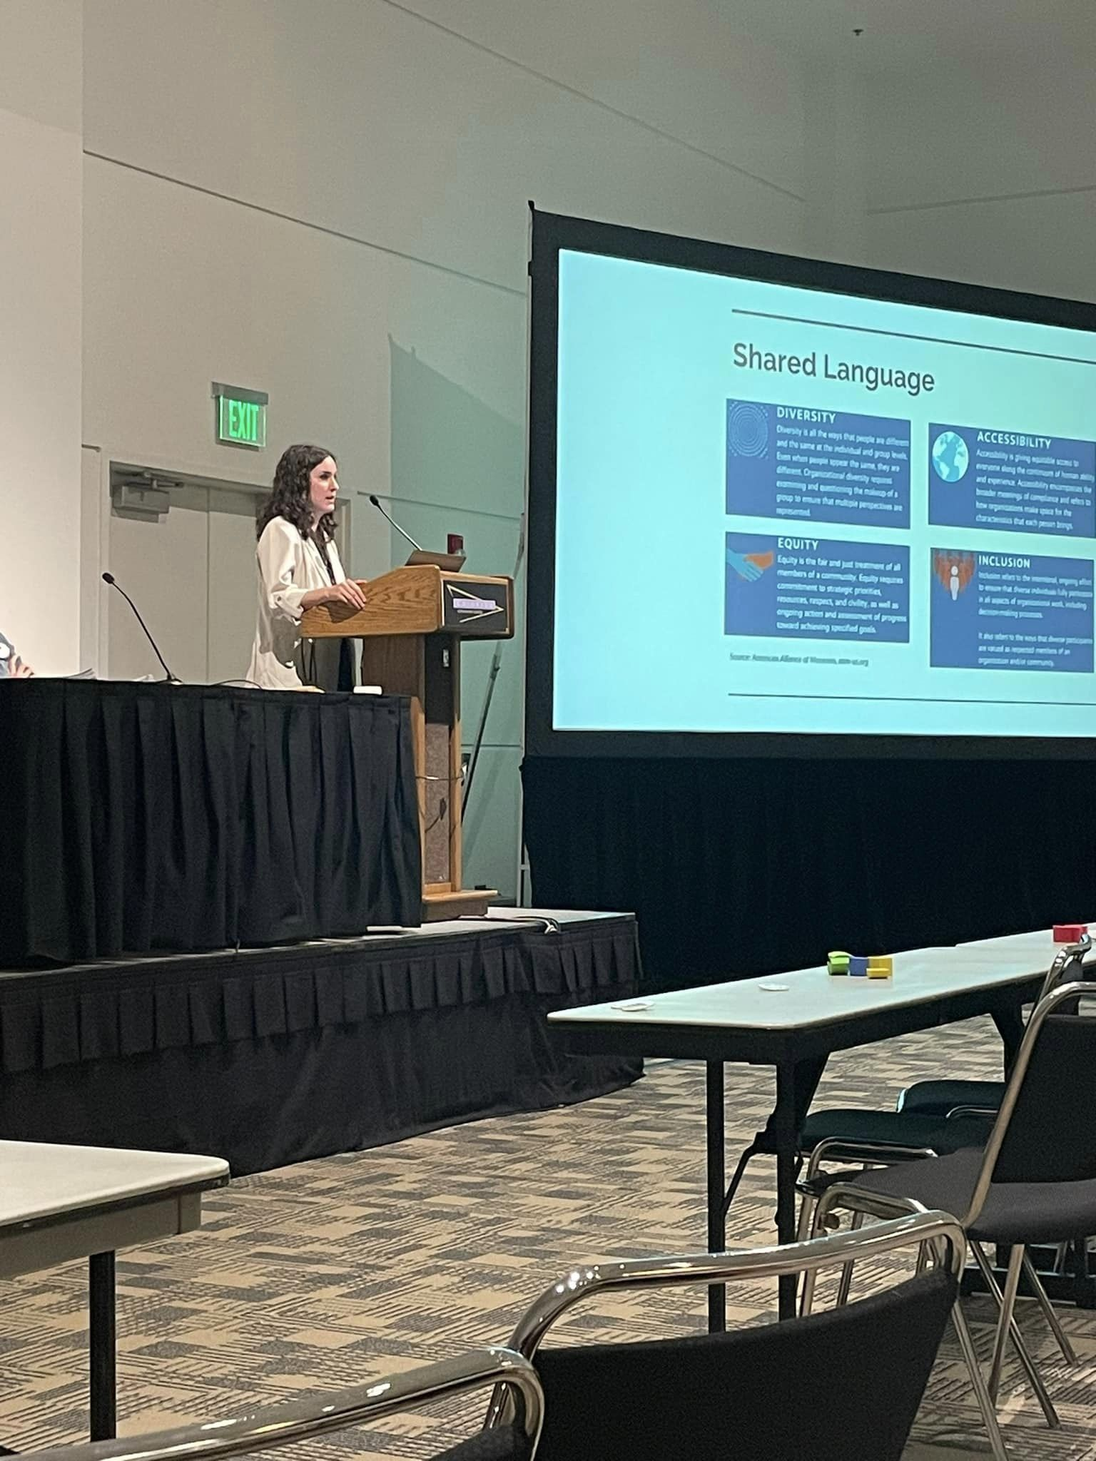
Keep it Inclusive
Diversity, Equity, Inclusion, and Accessibility should be the lens through which we do all of our work, and your proposal should reflect that you have given thought to the intersection of these concerns with your topic
Do your research, continue your education. It’s not enough to mention DEIA without serious thought and commitment
Be mindful of the composition of your panel, and whose work you are referencing, representing, and amplifying
AAMV DEIA Toolkit: AAMV.org/diversity

Slide 6
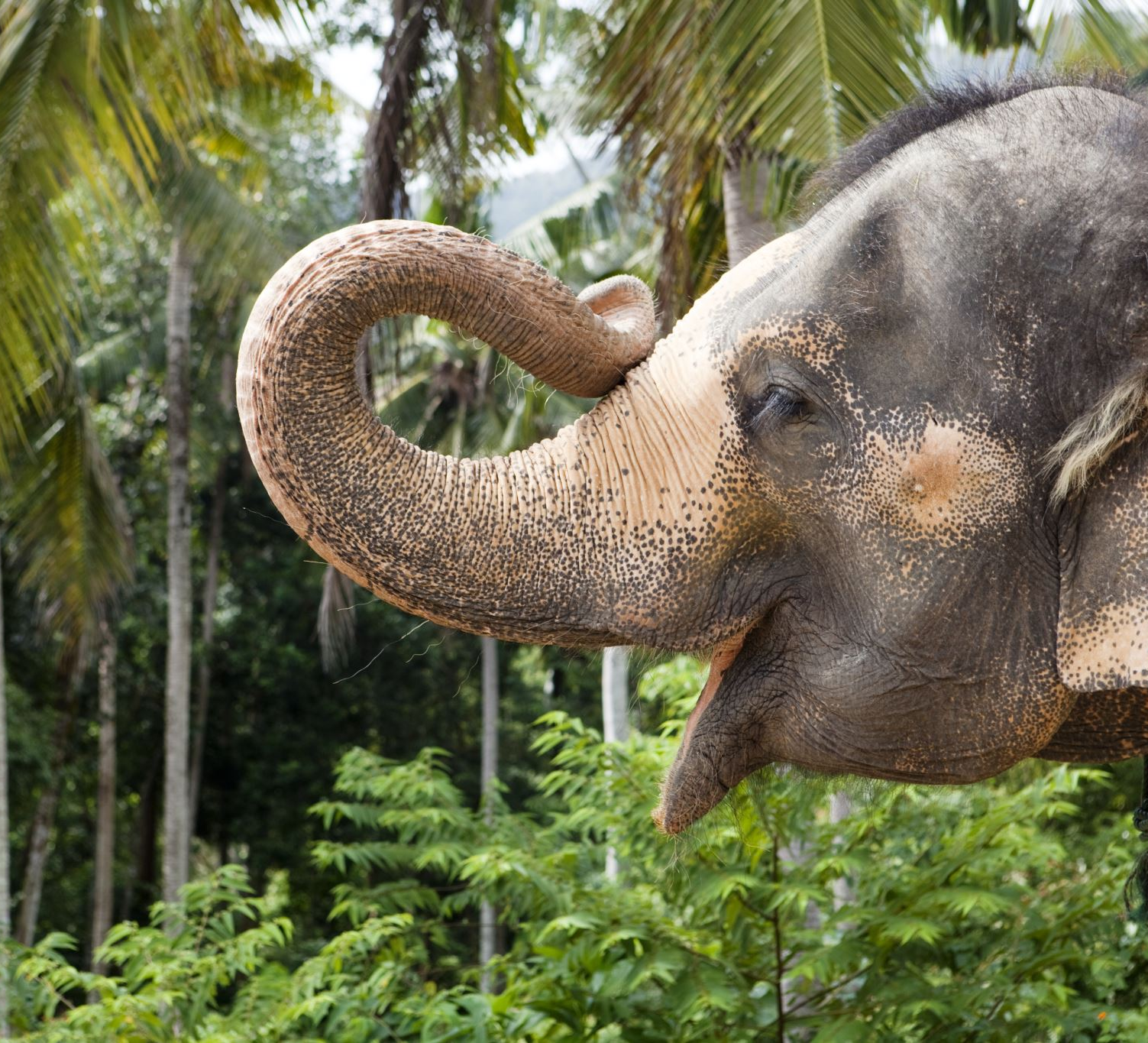
Embrace hot topics in the field
Address the elephant in the room
Feel empowered to create conversation
It’s okay to not have all of the answers— but make the attempt to provide solutions and identify those who are doing a good job

Slide 7
Make it actionable
We’re here to find solutions, not just talk about the problems!

Slide 8
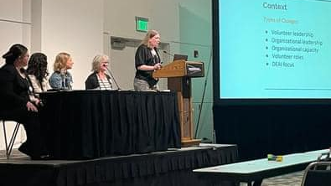
Upcoming Deadlines and Themes
American Alliance of Museums: September (TBD); “Thriving Museums, Healthy Communities”
annualmeeting.aam-us.org/callforproposals
MuseumNext: September 10; open theme
National Council for History Education: September 25; “History at the Crossroads”
The Inclusive Museum: November 13 (advanced submission); “Visitors, Collections, Representations”

Slide 9
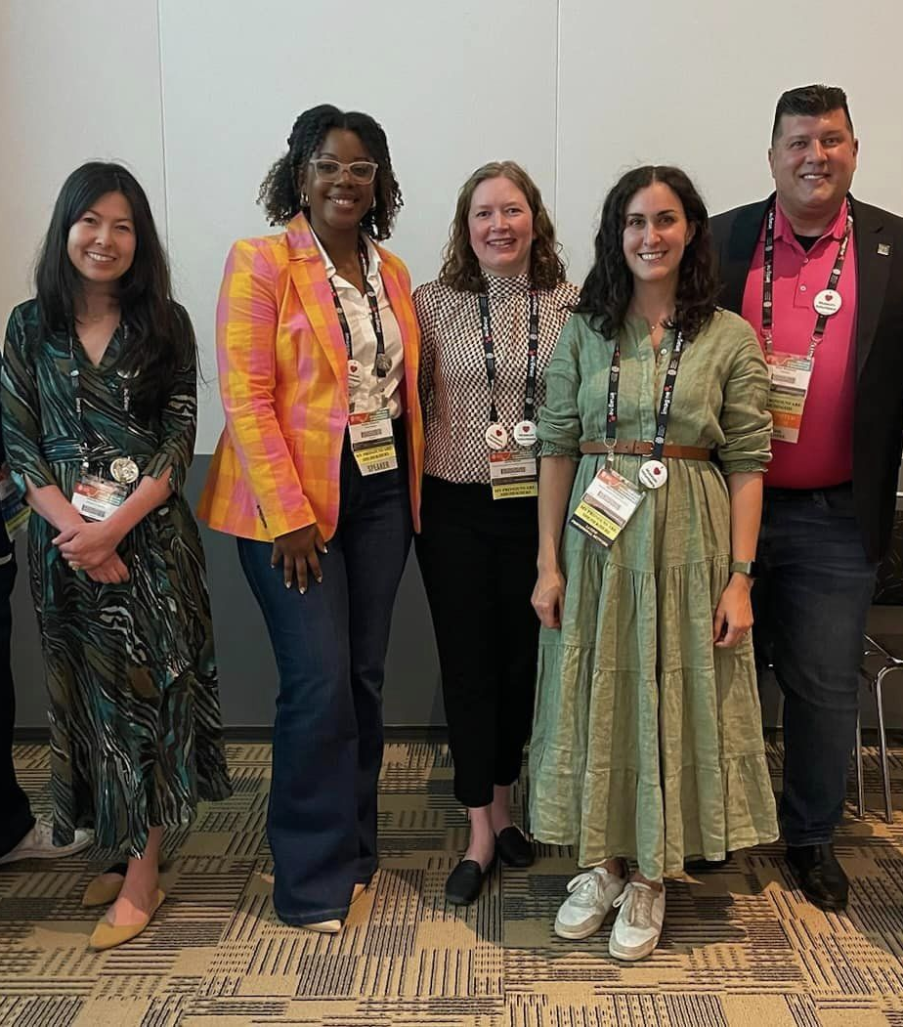
Fitting the Theme
How does your organization and/or community define well-being?
How do you integrate health and well-being principles into your organizational culture and workplace practice and foster it with staff?
In what ways are you fostering physical and mental health?
How do museums’ curation, collections, education, and exhibitions advance the public’s personal, intellectual, social, and physical well-being?
In what ways are you fostering social inclusion, connection, and belonging?
How do you create physical and virtual spaces that promote reflection, resilience, and renewal?
How can internal and external communications cultivate trust, authenticity, affirmation, and engagement among museum staff, audiences, and communities?
What partnerships and relationships have you cultivated or strengthened in shared purpose and meaning? What do effective partnerships look like to you?
How does your museum support and foster community and individual resilience?
How does your museum leverage its credibility and power as an agent for systemic change and social justice?
In what ways are museum programs designed to elicit awe, wonder, inspiration, and other feelings that foster well-being?
How can we support the well-being of displaced, dispossessed, and subjugated people, through stewardship and the protection of cultural resources, heritage, and identity?
annualmeeting.aam-us.org/callforproposals
Notes:
This is essential. You need to clearly connect your proposed session to the conference theme in the proposal.

Slide 10
What Would you like to see, and how do you fit the theme?

Slide 11
What issues would you like to address or See Addressed in the field?

Slide 12
Questions, Networking, Workshopping & General Discussion

